Slide 1

INFO 570 Data Wrangling & Analysis
Group 1
Ramat Ibrahim Maggie

Slide 2
Agenda
Introduction
Describing Dataset
Descriptive Analysis
Data Preprocessing
Fitting Models
Conclusion

Slide 3

Introduction
Spotify is a Swedish audio streaming and media service provider founded in 2006.
It is one of the largest music streaming service providers with over 574 million monthly active users.
It offers either free or premium services for a fee.
It generates the revenue from subscriptions and advertising.
Characterized by strong brand recognition and brand loyalty among users.

Slide 4





Problem Statement
Spotify is concerned with their revenue and future growth, With over 36% market share among online music subscribers and having a base of over 100 million subscribers.
We were asked to analyze their portfolio and identify characteristics that make some songs more successful than others.
We will analyze the song records provided.
The dataset can be used to develop predictive models or machine learning algorithms that forecast track popularity based on numerous parameters. To improve model accuracy, additional data and features could be added.
This analysis can be used as a starting point for music industry professionals, scholars, and music lovers interested in exploring trends and patterns in the ever-changing music world.

Slide 5
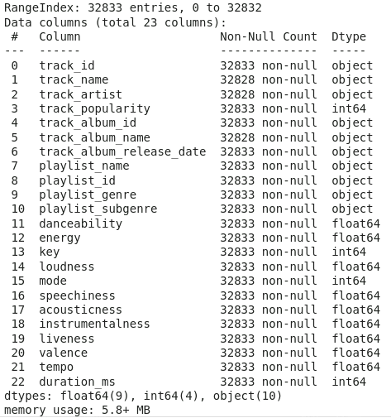
Data Used (Abeer)
The Spotify data used for this analysis is a contiguous dataset of over 30,000 songs with 12 audio features for each track, including confidence measures such as acousticness, liveness, speechiness, and instrumentalness; perceptual measures such as energy, loudness, danceability, and valence (positiveness), and descriptors such as duration, key, tempo, and mode.
Rows: 32,823
Columns: 23
Numerical variables: 13
Categorical variables: 10
Target variable: Track Popularity

Slide 6
Data Dictionary (Abeer)
Acousticness: Measure from 0.0 to 1.0 of whether the track is acoustic.
Danceability: Measure from 0.0 to 1.0 how suitable a track is for dancing.
Duration_ms: Duration of the track in milliseconds.
Energy: Measure from 0.0 to 1.0 and represents a perceptual measure of intensity and activity.
Valence: Measure from 0.0 to 1.0, describing the musical positiveness conveyed by a track.
Instrumentalness: Measure from 0.0 to 1.0 that predicts whether a track contains no vocals.
Liveness: Measure from 0.0 to 1.0 that detects the presence of an audience in the recording.
Loudness: The overall loudness of a track in decibels (dB) from -60 to 0
Speechiness: Measure from 0.0 to 1.0 that detects the presence of spoken words in a track.
Key: The key the track is in, 0 = C, 1 = C♯/D♭, 2 = D, and so on.
Tempo: The overall estimated tempo of a track in beats per minute (BPM).

Slide 7
Our approach (Abeer)
Since a song can be associated with multiple genres on Spotify, there may be cases of multiple instances of the same song appearing while analysing
Identify the association between different types of songs
An overview of the genres
An analysis of the track popularity
Fitting model

Slide 8
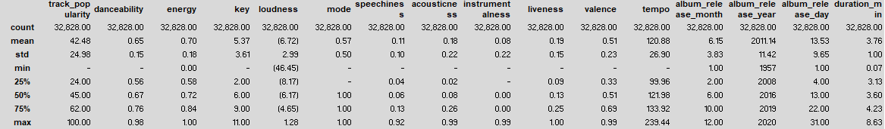
Descriptive Analytics- Correlations (Abeer)
Key Insights:
It appears that track_popularity has no strong link with any of the features provided.
The average duration of a song in the dataset is 225799.811622 ms or 3 minutes and 45 second.
Maximum duration of a song in the dataset is 8.63 minutes; Minimum of a song in the dataset is 0.07 minutes.

Slide 9
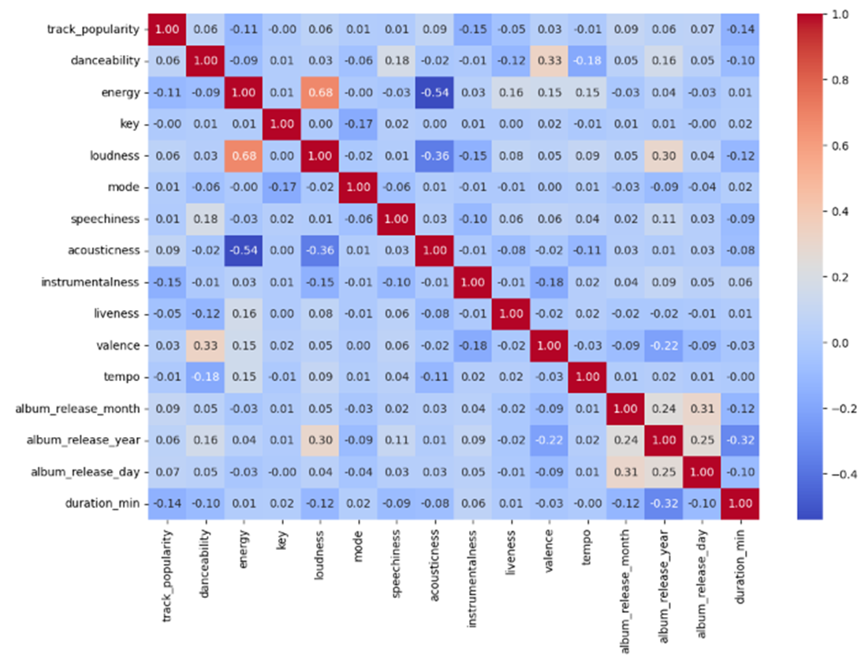
Correlation- Heat Map continued (Abeer)
Creating correlation matrix by using a heatmap for numeric only variable
With a -0.14 connection between track_popularity and duration_ms, longer tracks are associated with lower track popularity on average. The connection is weak, and other factors may play a role in the overall picture.
According to the correlation value of -0.15, tracks with more instrumentality are connected with lower track popularity on average. The association is weak, and other variables may influence track popularity.
The playlists' genres are largely evenly represented.

Slide 10
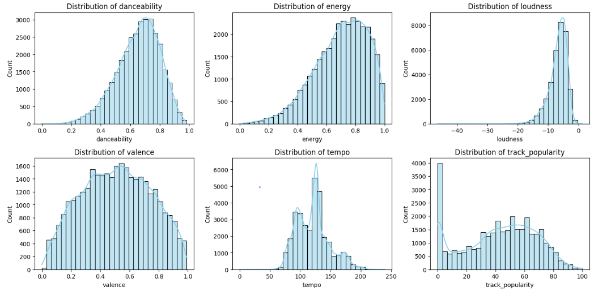
Descriptive Analytics continued (Abeer)
visualize descriptive statistics of each variable

Slide 11
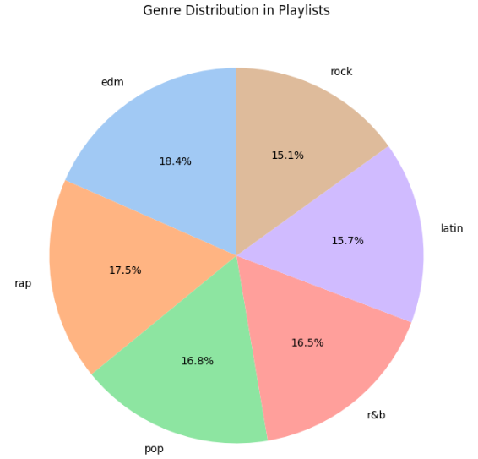
Dataset Visualization (Abeer)
Analyze closely genres percentage in the dataset and found that edm has the highest share of 18%, and lowest is rock which is 15%.

Slide 12
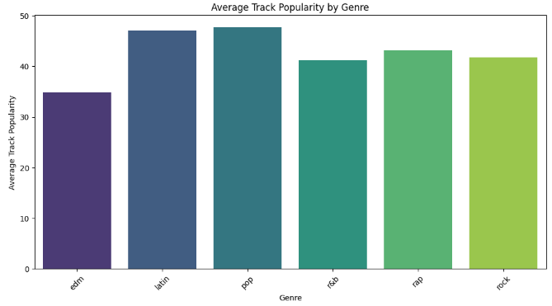
Average Track Popularity by Genre (Abeer)
Pop genre has the highest average track popularity, followed by latin genre and the lowest in that graph is edm genre.

Slide 13
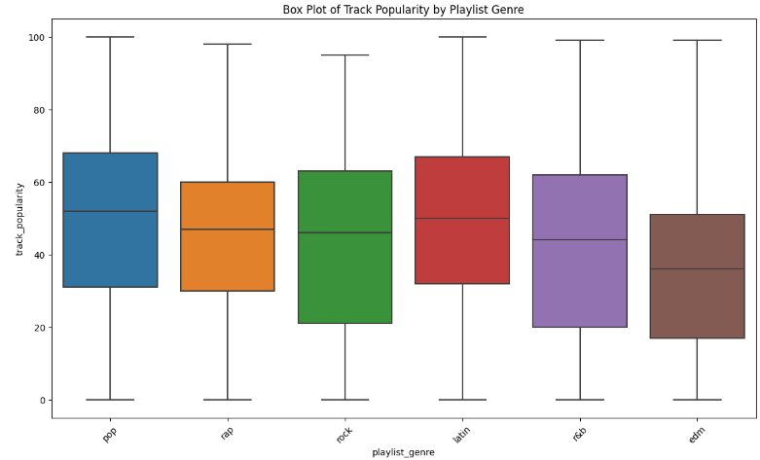
Track Popularity by Playlist (Abeer)
Using boxplot to identify the most track popularity by playlist genre.
It shows that pop genre has the highest track popularity followed by latin and the lowest is edm genre.

Slide 14
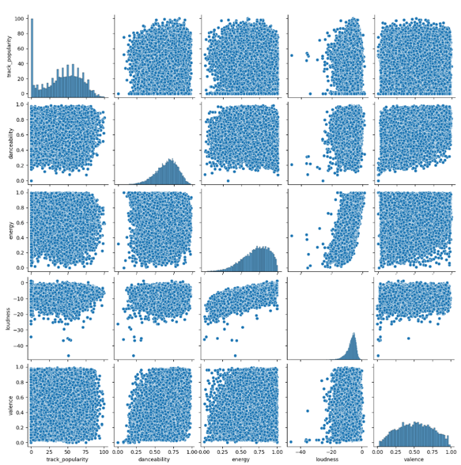
Genres of the Playlists (Abeer)
Using pairplot we identified that genres of the playlists are mostly equally represented

Slide 15
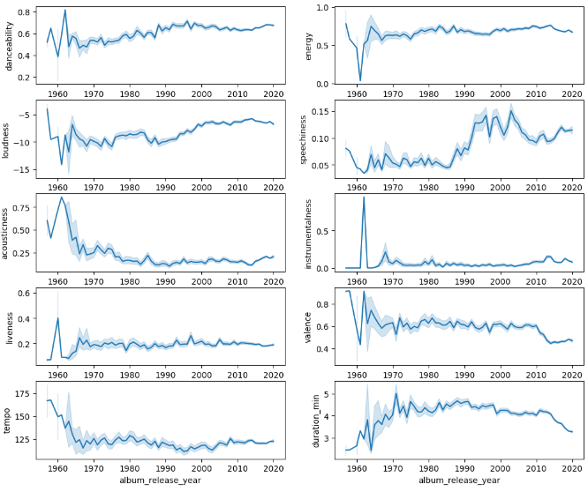
Song Key Feature over the Years (Abeer)
Using time series (year) to show how each variable behave over the years.
Energy, loudness, valence, and tempo genres started really high around 1960.

Slide 16
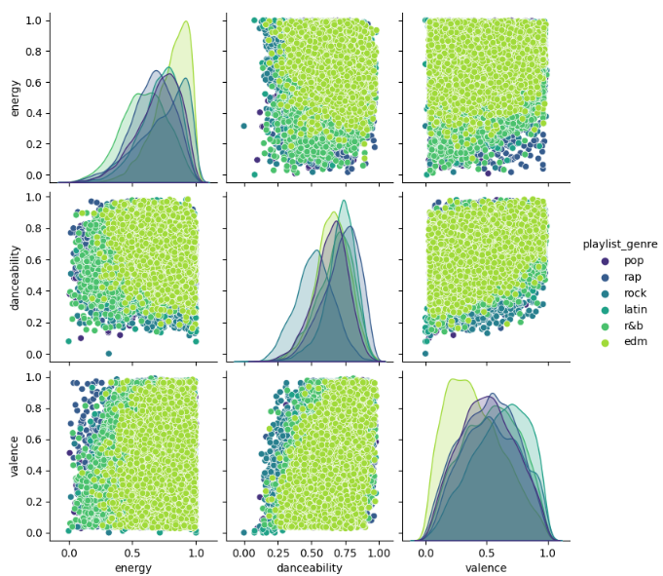
Playlist genre (Abeer)
Danceability and energy: There is a positive correlation between danceability and energy.
Songs with higher danceability tend to also have higher energy levels.

Slide 17
Data Preprocessing (Abeer)
Importing the libraries
Importing the dataset
Handling the missing values
Using data cardinality to measure of how many distinct values we have in a column compared to the number of rows.
High cardinality indicates a large amount of data entries with minimal repetition
Low cardinality indicates a large amount of data entries that repeat
Using cardinality enhance our data modeling
Removing outliers
Features Selection
we have selected total 15 features for data modeling
track_popularity is target column
Encoding Nominal/categorical collumns(genre and subtype genre)
Standardizing columns with abnormal range values(tempo and loudness)
merging encoded nominal columns with numeric columns
converting continuous target column to binary column(no applicable for linearregression
train, test splitting with 20 percent for testing

Slide 18
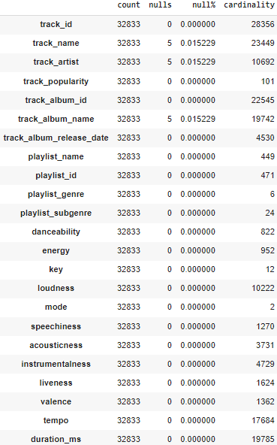
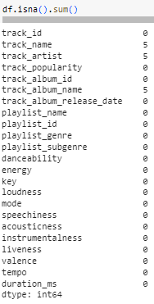
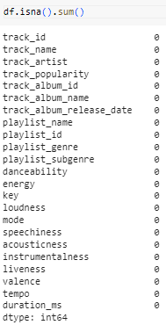
Preparing the Dataset (Abeer)
Using cardinality to identify distribution of the data and optimization model
Checking if there is any null values
Checking if there is any null values

Slide 19
Fitting Model
We used three algorithms:
Linear Regression(for regression)
DecisionTreeClassifier(for binary classification)
LogisticRegression(for binary clasifcation)

Slide 20
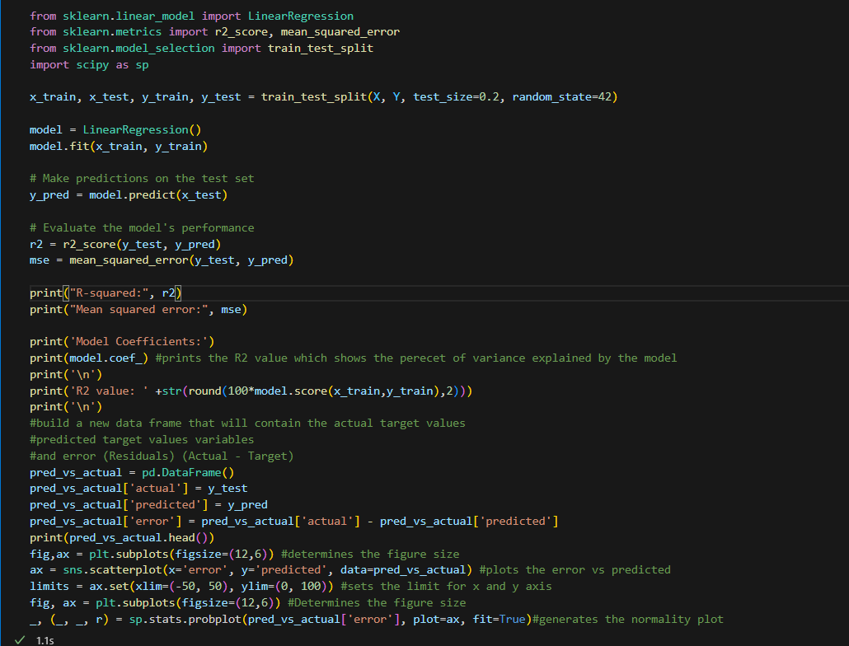
Linear Regression Model

Slide 21
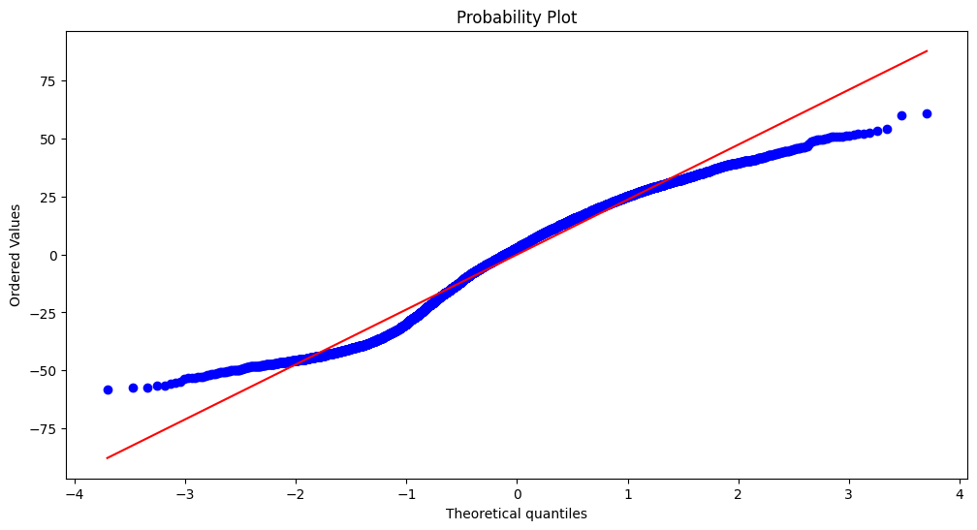
Result

Slide 22
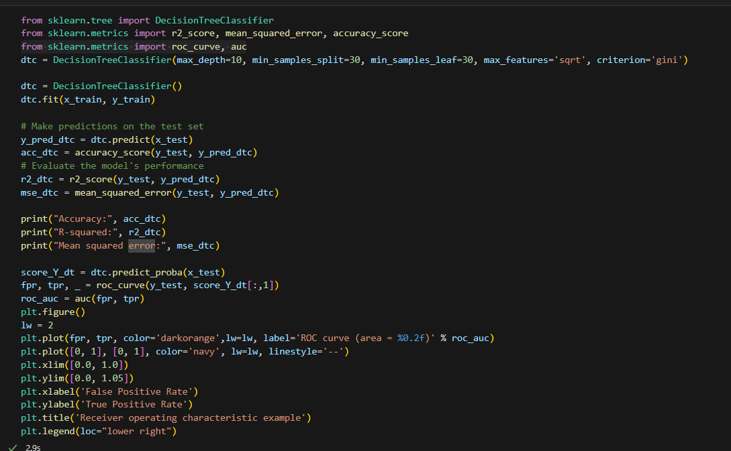
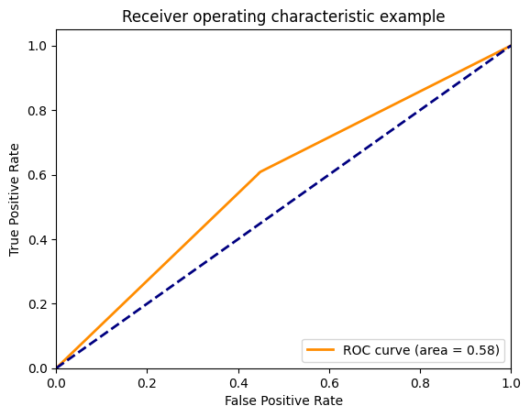
Decision Tree
ROC Curve
Code

Slide 23
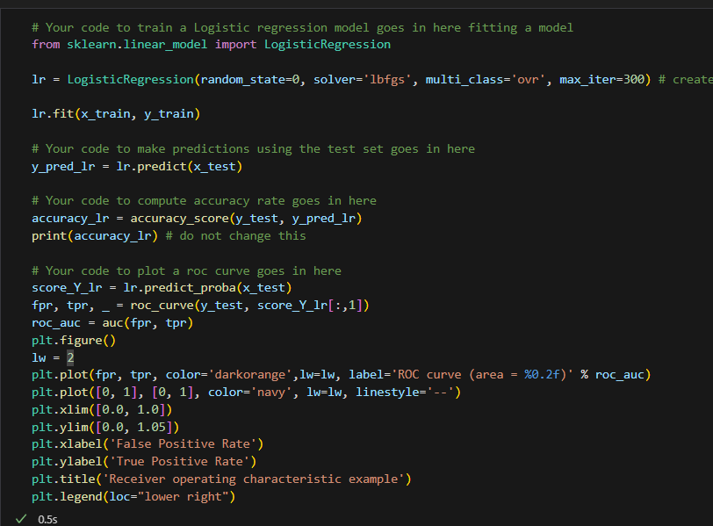
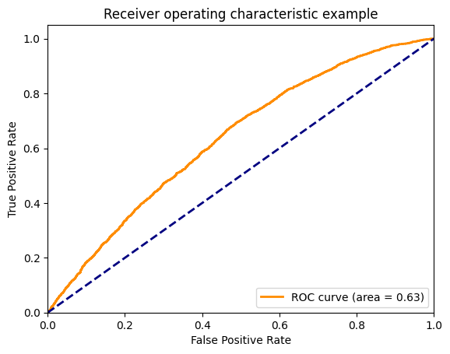
Logistic Regression
ROC Curve
Code

Slide 24

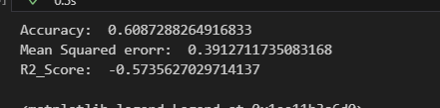
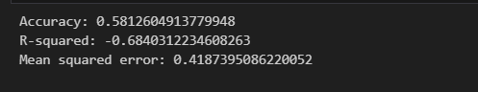
Performance Comaprision of All Algorithms
Linear Regression
Logistic Regression
Decision Tree

Slide 25
Conclusions (Abeer)
A song in the dataset has an average duration of 225799.811622 ms, or 3 minutes and 45 seconds. Rock and edm are more energetic. R&B music is usually the least energetic.
Pop and latin music are generally more popular.
EDM is a less well-known genre.
It appears that track_popularity has no strong link with any of the features provided.
The energy of a music is likely to grow as the volume of the song increases. If the loudness falls, the energy is more likely to decrease.
Given the limited connections discovered, further features or external data may be required to better understand the variables impacting track popularity.
Exploring external factors such as artist popularity, release date, or geographical patterns may provide additional insights into the determinants of track popularity.
It could be interesting to undertake a more in-depth genre-specific research to identify trends and qualities that are distinct to each genre.

Slide 26
Conclusions continued (Abeer)
The dataset can be used to develop predictive models or machine learning algorithms that forecast track popularity based on numerous parameters. To improve model accuracy, additional data and features could be added.
Periodic updates to the dataset could capture evolving trends in music choices and help keep the analysis relevant over time.
The dataset provides an in-depth look at songs from diverse genres, allowing for a more nuanced understanding of their qualities and appeal.
The weak correlations imply that predicting track popularity is most likely impacted by a combination of factors that are outside the scope of the current dataset.
This analysis can be used as a starting point for music industry professionals, scholars, and lovers interested in exploring trends and patterns in the ever-changing music world.

